Slide 1
Team Name: 4 Brains 1 Cell
Members:
Kelly
Rebecca
Hashim
Hasan

Slide 2
What will be mentioned in this presentation:
We was given different mini projects to complete with each one being different, we was asked to build and test other networks.
MP1 Computing: PC architecture and SQL
MP2 Software Eng: Pennine Pizza Works
MP3 Networking: Studio Network
MP4 Cyber-Security: cyber-security awareness writing

Slide 3
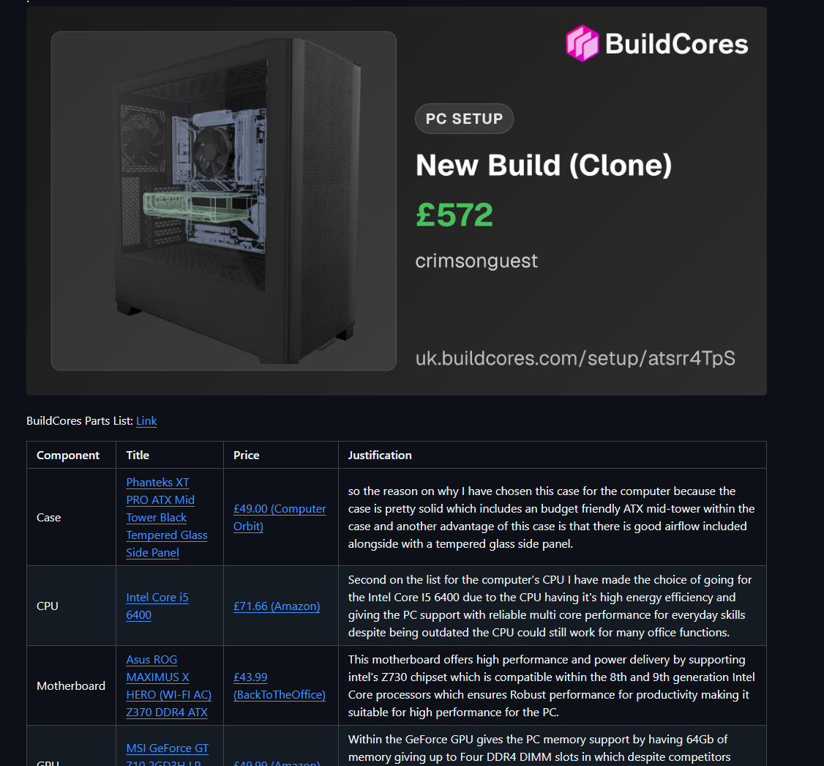
Mini Project 1: Northwest Architecture Studio Ltd.
The PC build made in BuildCores
In this mini project we was tasked to make a 3D model using buildcores to create a computer model from scratch with a specific budget
Budget:£850
Role: Administrative Assistant

Slide 4
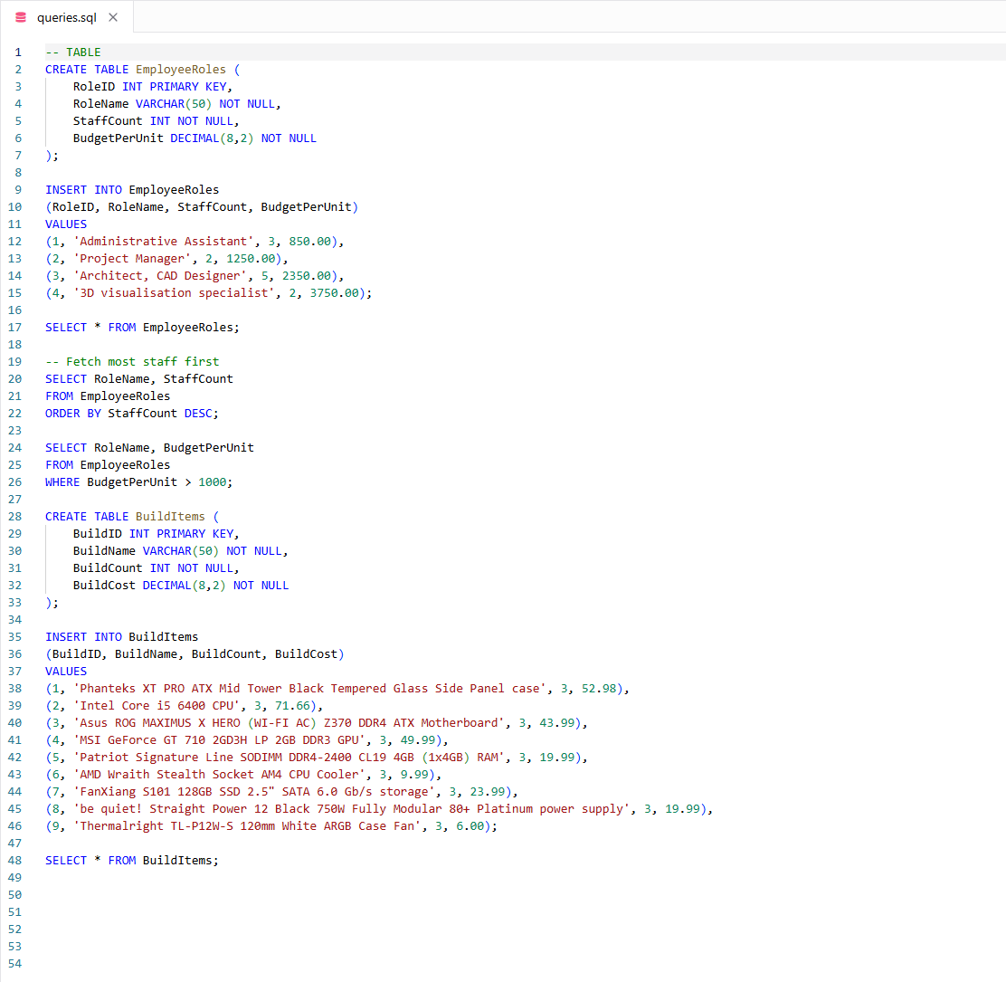
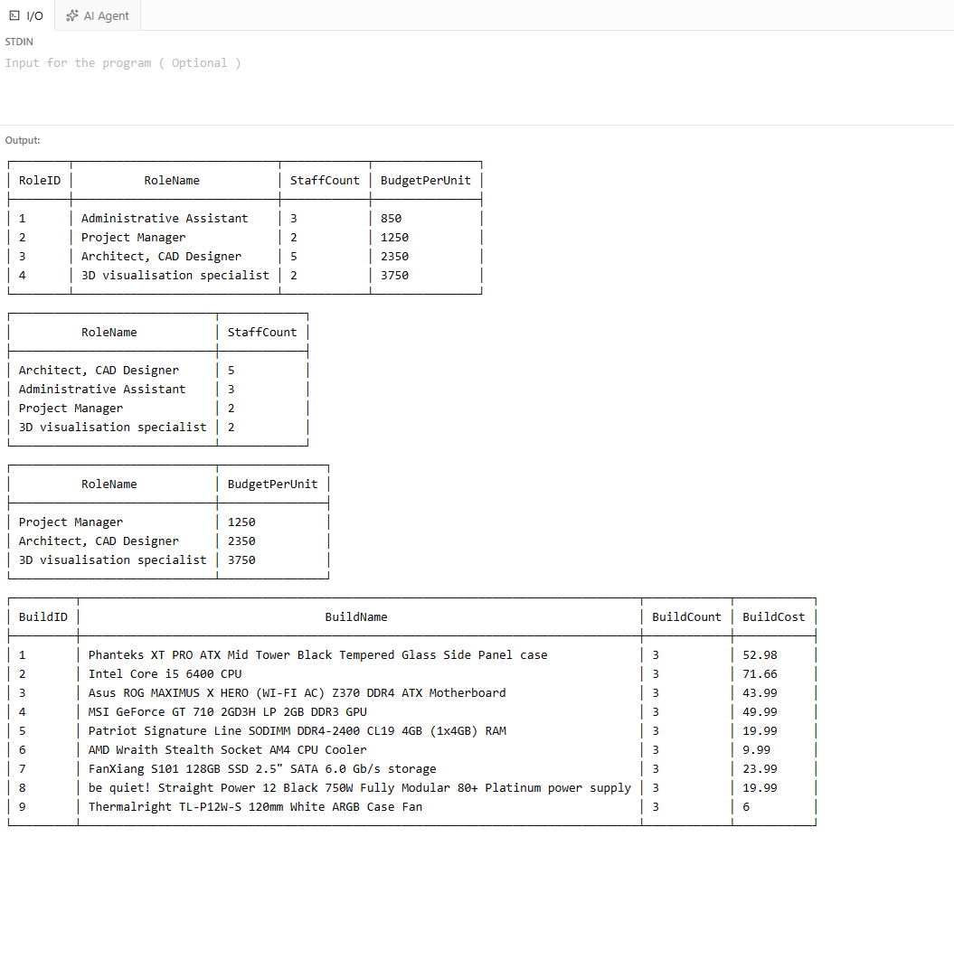
Mini Project 1: Northwest Architecture Studio Ltd.

Slide 5
PENNINE PIZZA WORKS
MINI PROJECT 2

Slide 6

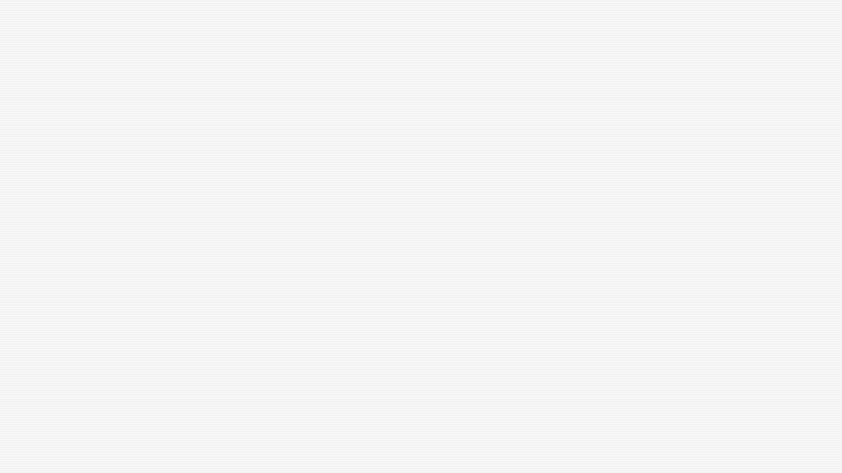
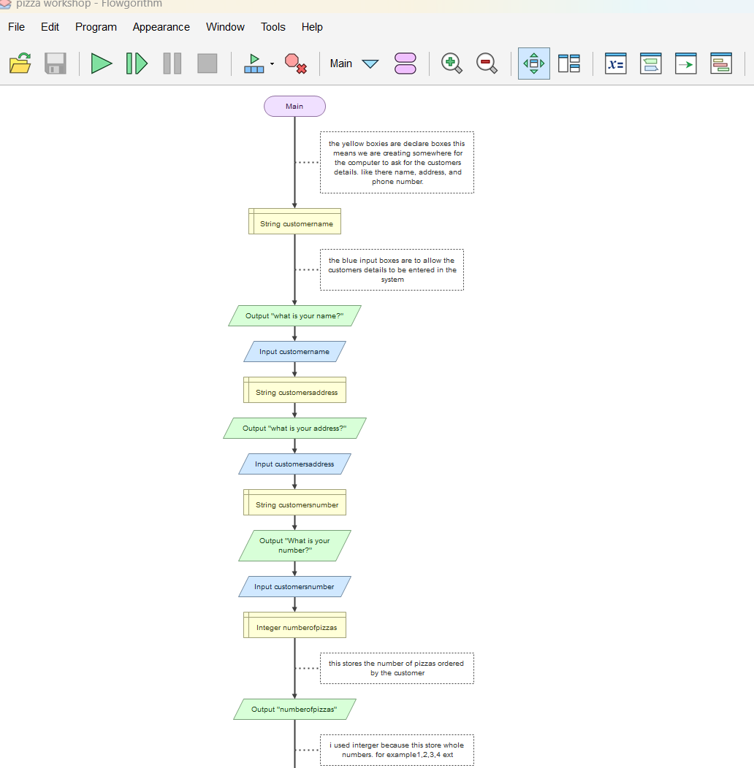

Mini Project 2: Pennine Pizza Works
This was quit hard for me to do but has I got in the flowgaritham it was not too bad. I have written in the comment box at side of them so I could I understand the structure as I was going along and what the boxes mean so I could remember them myself.

Slide 7
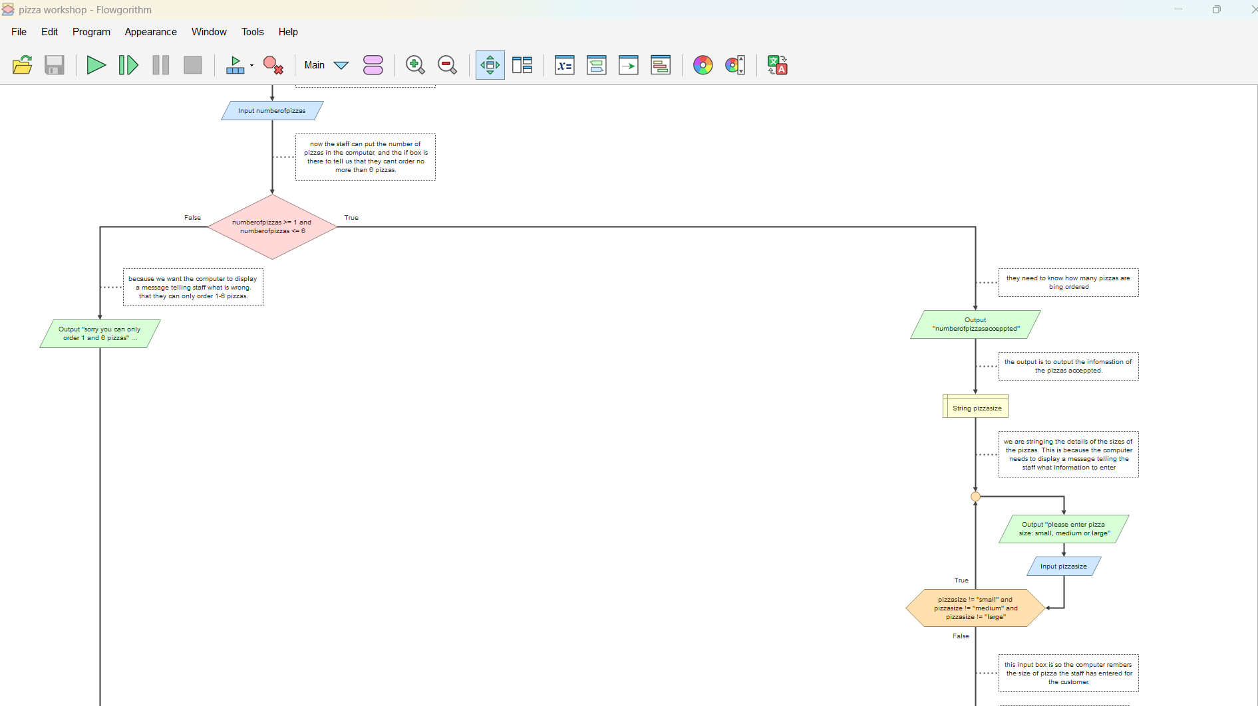
This section is where it got tricky because the red box is an if box and that is used so the customer can not order no more than 6 pizzas as it will come up with a message.
The orange box is a do loop this will repeat the massage.

Slide 8
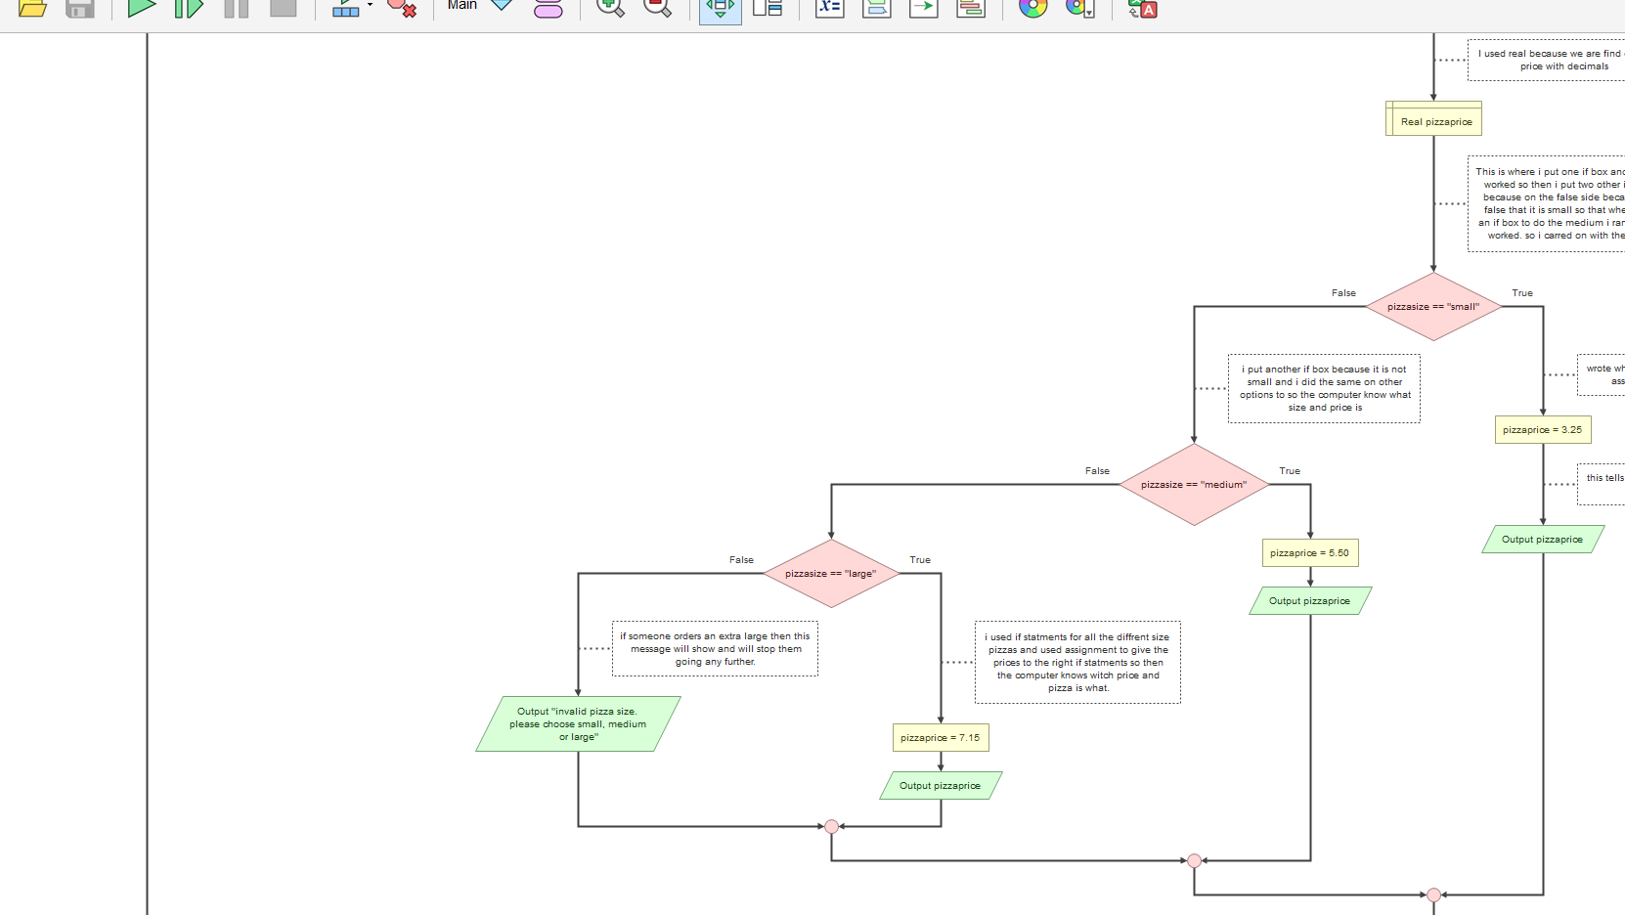
This section is for the pizza sizes and as you can see on the large pizza, I have put a message at the false side to where it will say invaid choice please chose small medium or large.
This also has the price as an assign so this will calculate and the outcome box is where it will tell you the price.

Slide 9
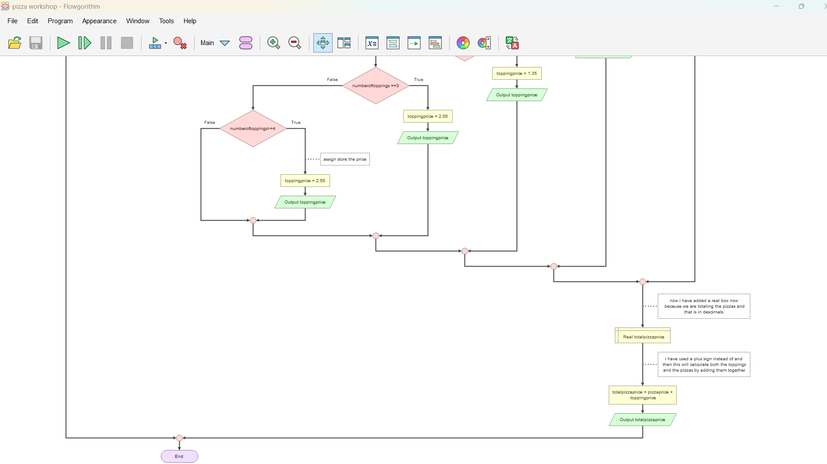
z
These screenshots show the final IF statements in my flowchart. I used == to check whether two values are equal, such as the pizza size or the number of toppings selected. I then used Assign boxes to set the correct prices and the + operator to add the pizza price and topping price together.
The next power point is a video showing you that it works.

Slide 10
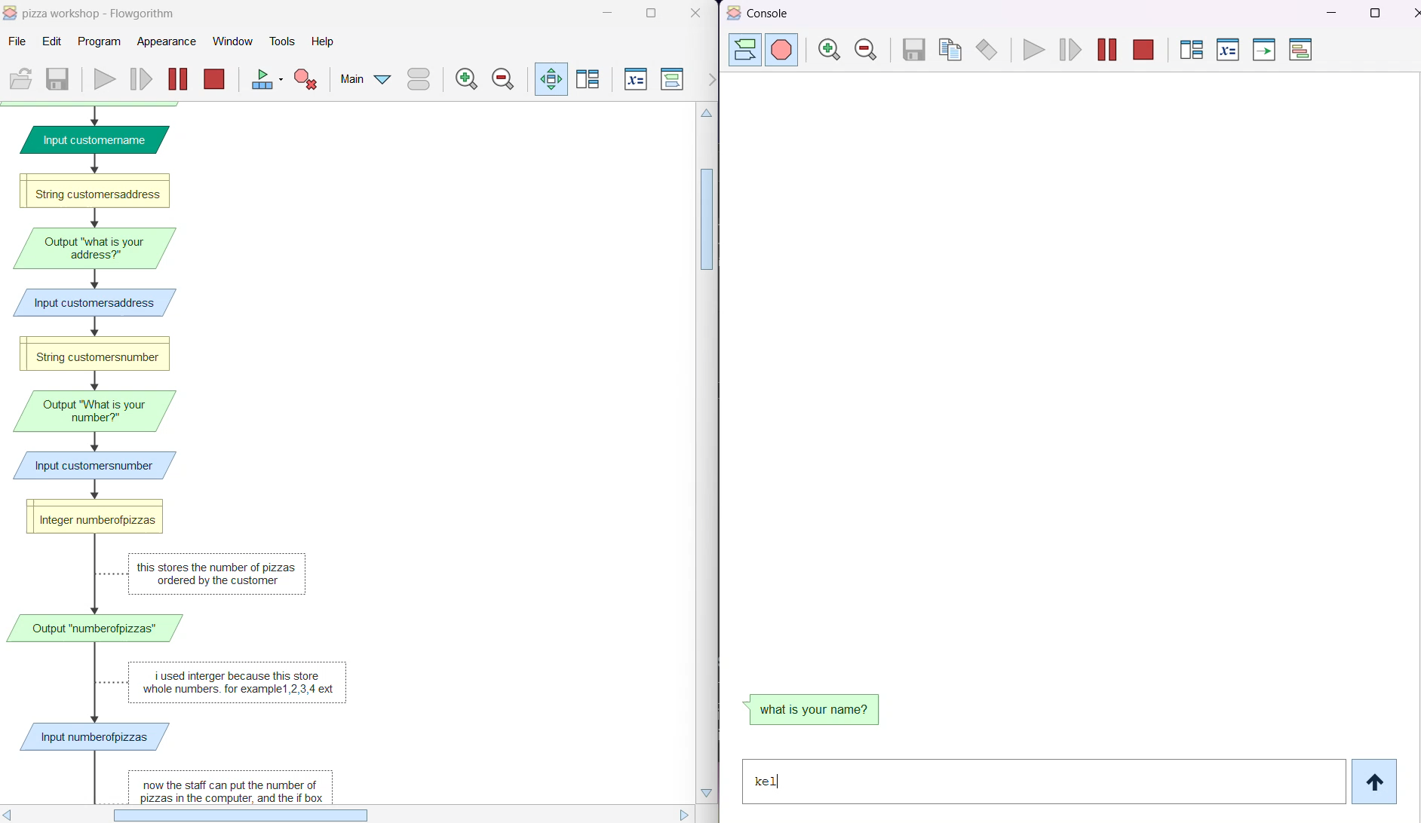

Slide 11
Mini Project 3:
NorthWest Architecture Studio
Network
z

Slide 12
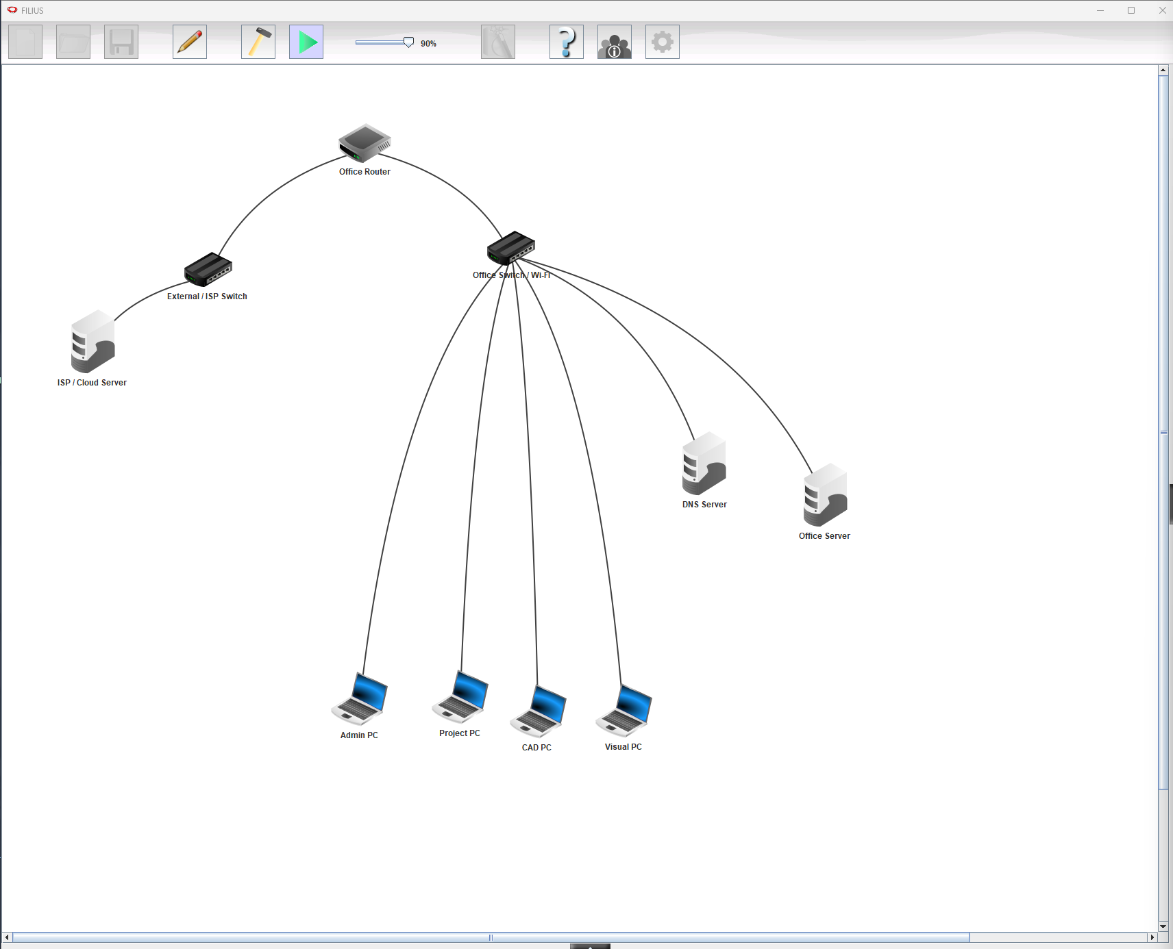
The Brief: Northwest architecture Studios has asked to model a working LAN and a connection to a external cloud/ISP
The problem:
We had to create a working network for Northwest Architecture Studio
Connect the office LAN to a cloud network.
Configure the IP addresses

Slide 13
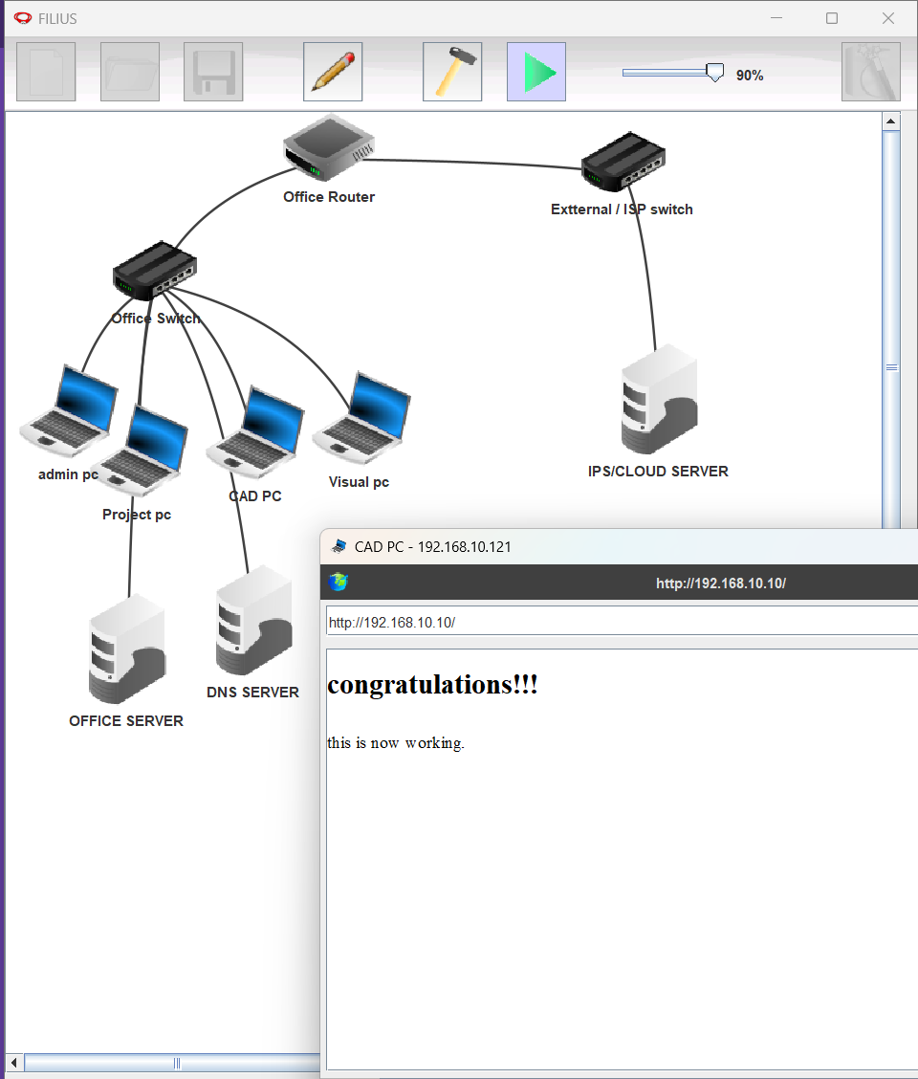
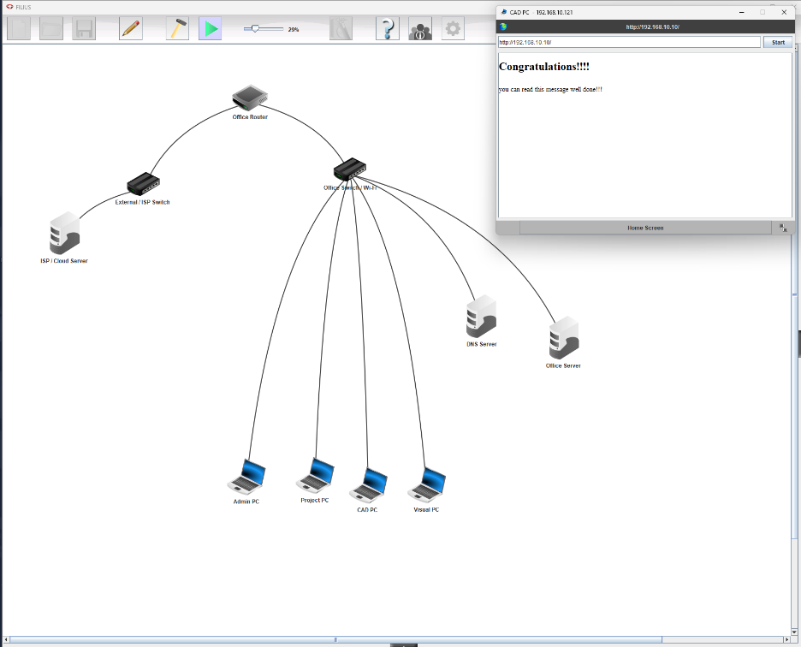
Tested that it can run on local intranet

Slide 14
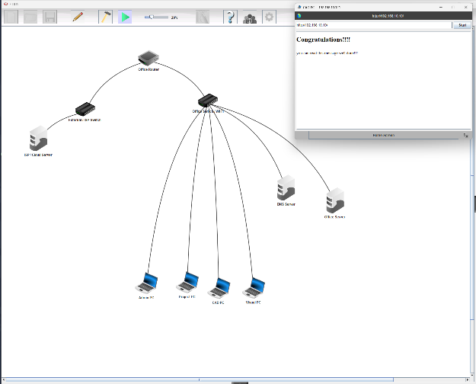
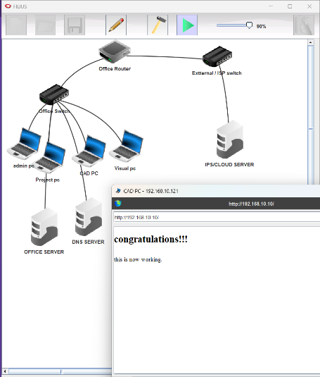
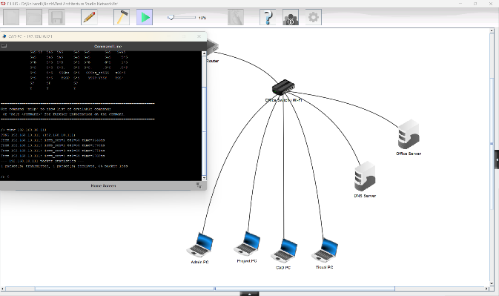
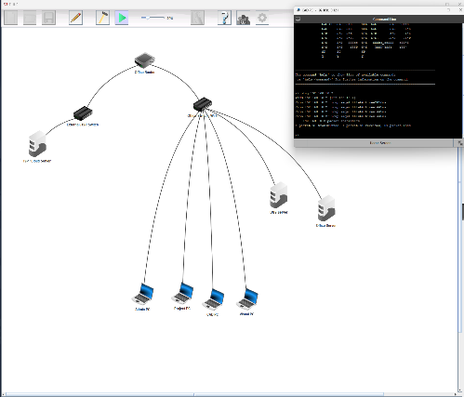
Made sure the computer can connect to the office server and display a page from the intranet
We ran numerous tests to make sure the network worked according to the brief
Tested that the computers can talk to each other to make sure
the computers can communicate with each other
Checked connection to the DNS Server

Slide 15
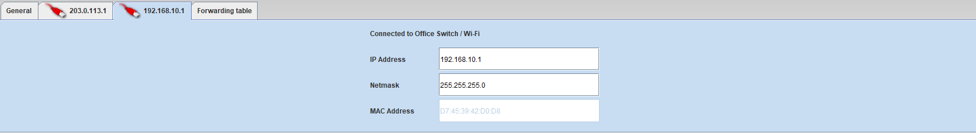
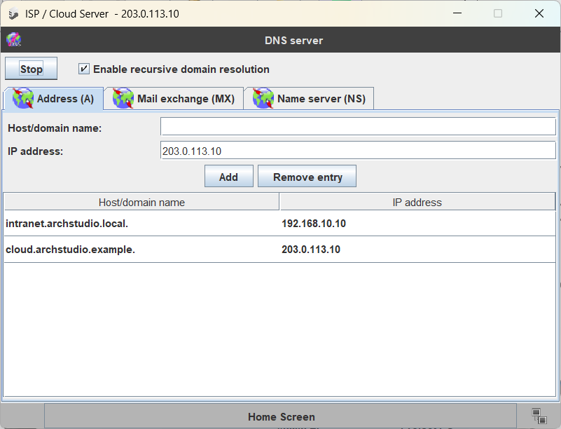
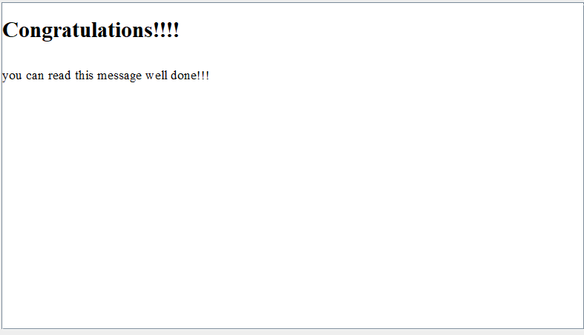
Configured the devices so that they can communicate with the ISP
Configured DNS Server:
Created a page using HTML to test the cloud
and intranet servers

Slide 16
Mini Project 4: Cyber-Security Awareness

Slide 17
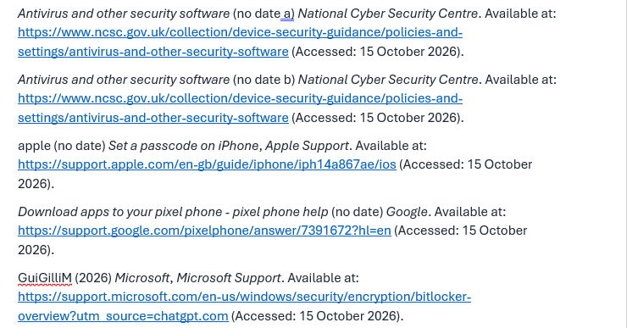
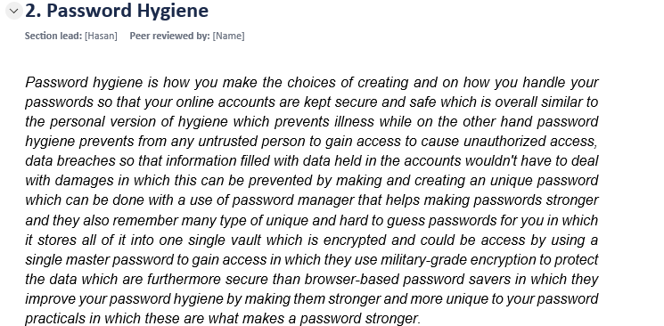
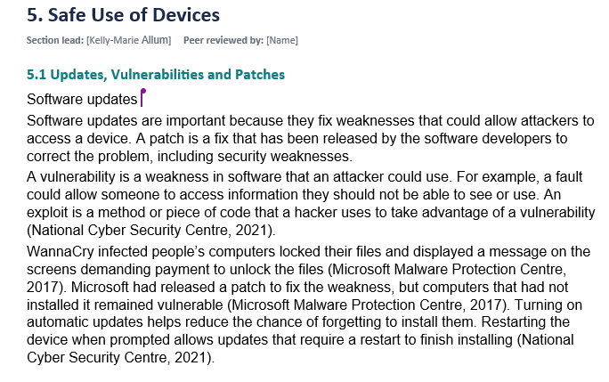
Mini Project 4: Cyber-Security Awareness
We was asked to do some researches on cybersecurity regarding certain topics, we was asked to explain why cybersecurity awareness matters and how we can possibly stop it from happening. The topics which we was asked to research are one of the main and high risks within cybersecurity. The topics we was asked to research are:
1.) Password hygiene.
2.) Two factor and multi factor authenticator.
3.) Phishing.
4.) Safe use of devices.
5.) Safe use of public-wifi.
As you can see on the right it shows evidence of our report on the topics provided to us, we have each explained what a topic is , how they are used and how to prevent this from happening to anyone. Also we was asked to add appropriate citations (harvard referancing), and as you can see on the right there are example of how and when they are being used in our cybersecurity report .

Slide 18
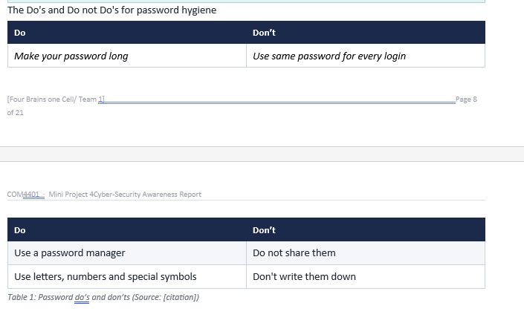
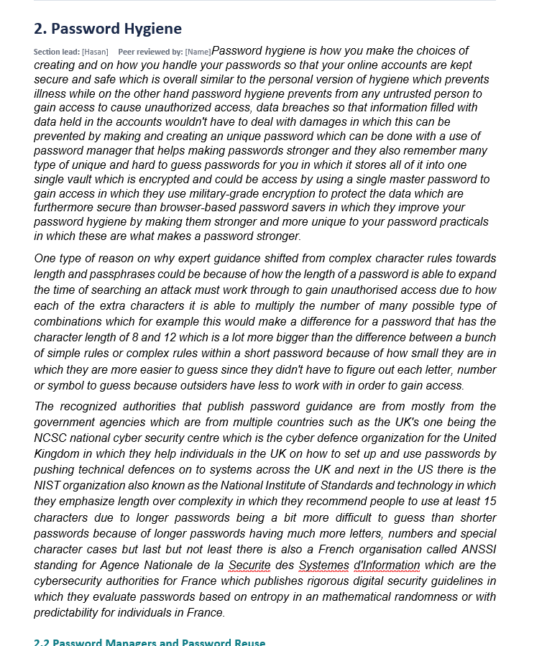
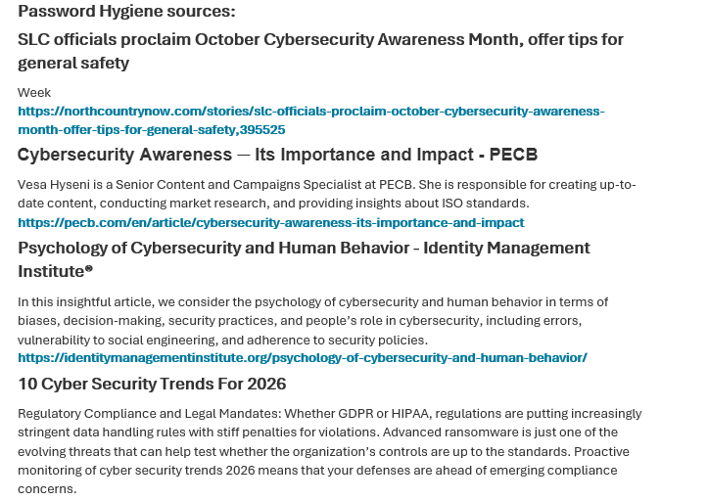
Over here on this slide you can also see a table was made regarding on what to do and what not to do for making a password to make your account safe and protected. This helps shows how important it is to have a safe password and the requirements for a safe password, the same was also explained for the other topics.
Also we have provided a sources section at the end of the page, to show where we have gotten our information from.

Slide 19
Conclusion:
M1:
M2: In conclution I did struggled with this as I know nothing about this subjects. I used AI to understand the context. Then I cross-checked this with sources from Google, then wrote comments to show that I have learned this. I found this subject and more interesting did I still struggle with this yes but I would like to learn more.
M3: In conclusion this project improved our understanding of Networks and how they communicate with the right settings showed us how to properly configure the network so that it will run smoothly yes there was problems to troubleshoot but it worked in the end.
M4: So overall for cyber security awareness individuals would need to make very long and secure protocols to keep their hardware safe from threats

Slide 20
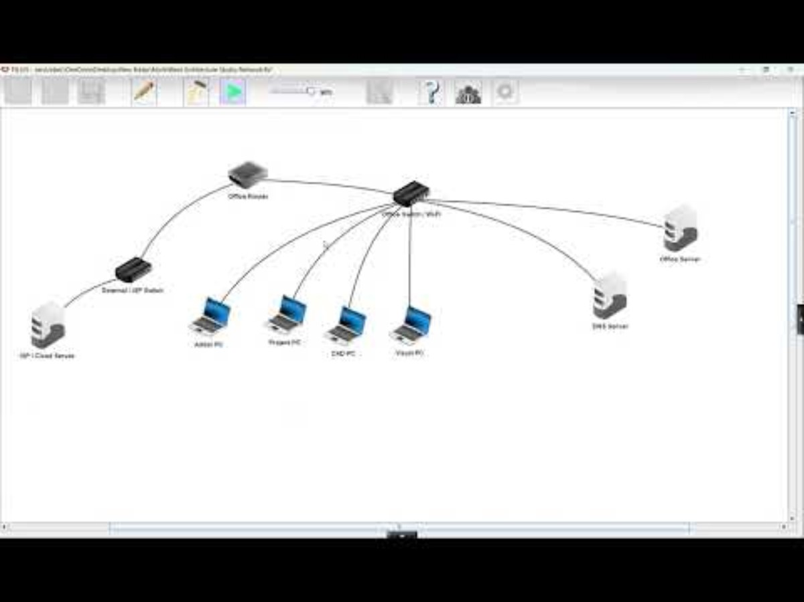
Live Demo
z

